Slide 1
Seasonal Agriculture Performance Analysis
Name : Krishna Mohan B
Student ID: STU67c74640ed4b11741112896
College Name: Amity University Online (Passed Out)

Slide 2
Problem Statement of Seasonal Agriculture Performance Analysis
Agricultural activities are influenced by seasonal variations in environmental conditions, farming practices, resource availability and market conditions. As a result, agricultural performance may differ from one season to another. However, raw agricultural data does not clearly explain how agricultural performance changes across seasons or what patterns can be observed in different seasonal conditions. The problem is to analyze the given agricultural dataset and investigate seasonal differences in agricultural performance by identifying meaningful patterns, trends, relationships and variations within the available data.
Importance of the Problem Statement
Seasonal variations can influence different aspects of agricultural activities and performance.
Understanding seasonal patterns through data analytics can help stakeholders:
Understand variations in agricultural performance
Identify important seasonal trends
Compare performance across different periods
Understand changing environmental conditions
Examine differences in resource usage
Identify areas requiring further investigation
Support evidence-based agricultural planning

Slide 3
Project Description of Seasonal Agriculture Performance Analysis
This project aims to characterize and examine seasonal agriculture performance across farms and will relate environment, soil health, farm inputs to farm outcome, for example, precipitation, temperature, soil nutrients, types of irrigation, the use of inputs and crop performance-both yield and income. Understanding relationships between environmental and production practices with farm outcome characteristics will provide insights on which production-resource use strategies will optimize crop yield, optimize use of resources, particularly water and fertilizer, achieve a better farm economy and mitigate disease/pest problems for variety of crops, seasons, and regions.
Dataset Description
Dataset to hold farm level records containing various features related to environment, agriculture and finance of specific crop and season. Each row would represent the performance records of the one farm which can be defined as below:
Farm_ID- unique id to denote the farm
State, District- geographical location of the farm
Crop, Season - crops that has been grown and season of the year respectively
Farm Area Hectares - total cultivate area of the farm

Slide 4
Climatic Conditions:
Rainfall_mm- total rainfall received by farm in season
AvgTemperatureC - average temp by which crop cycle has flourished
Humidity_pct- average percentage humidity during the crop cycle
SunlightHoursDay- average daily exposure of sun to the crop
Soil Characteristics:
Soil_pH- pH value indicating acidity/alkalinity of soil
SoilMoisturepct- average water content in soil as percentage
Nitrogenkgha, Phosphoruskgha, Potassiumkgha- Nitrogen, Phosphorous and Potassium composition of soil
Farming inputs and practices:
Irrigation_Method- method through which the land is been irrigated (Drip, Canal, Sprinkler, Rain-fed)
Fertilizerkgha- per hectare rate of fertilizer usage
PesticideLitreha- per hectare rate of pesticide usage
SeedQualityScore - performance of seed quality (1-5)

Slide 5
Yield & Production:
YieldTonnesHa - yield rate of crop per hectare
Production_Tonnes - total production in tonnes by the farm
Financials:
MarketPriceINR_Tonne - market rate at which crop can be sold
TotalCostINR-total expenses by the farmer
Revenue_INR- total earnings made from the yield
Profit_INR- net profit
Resource efficiency and risk:
WaterUsedm3 - total volume of water utilized for farm at a season
WaterEfficiencytper1000m3- total yield per 1000 m3 of water consumed
DiseasePestRisk_pct - potential percentage risk of attack of diseases/pests

Slide 6
Project Objectives
How does agricultural performance vary across seasons?
What major seasonal patterns can be observed?
Which characteristics change between seasons?
What differences exist between agricultural activities in different seasons?
Are there noticeable variations in resource usage across seasons?
Are there relationships between seasonal environmental conditions and
agricultural performance?
How do economic outcomes vary across seasons?
Are some seasonal patterns consistent across different regions or categories?
Are there unusual or unexpected seasonal patterns?
What insights can be derived from the observed seasonal differences?
What conclusions can reasonably be drawn from the available data?
How could the findings support better seasonal agricultural planning?

Slide 7
What is Data Wrangling ?
Data wrangling, a crucial phase in the data analysis process, involves preparing and cleaning raw data to make it suitable for analysis. This involves various tasks such as handling missing values, removing duplicates, and transforming data into a consistent format. Effective data wrangling ensures that the data is reliable and ready for exploration, enabling meaningful insights to be derived from it.

Slide 8
What is the Exploratory Data Analysis (EDA)
Exploratory Data Analysis (EDA)is a vital phase in data analysis involving the examination and visualization of data to uncover patterns ,trends, and insights.in the context of an Airbnb data analysis project, EDA allows researchers to gain a Comprehensive understanding of the dataset's characteristics, distribution and relationships between variables. Through techniques such as summary stastics, data visualization ,and correlation analysis, EDA sets the stage for further investigation and hypothesis testing, uiding subsequent analytical decisions.

Slide 9
End Users of this Project
1. Farmers and Agricultural Producers: Individual/smallholder farmers looking for guidance on the right choices for crops, irrigation and fertilization for their regions and season Large-scale commercial farmers aiming to optimize input costs and increase profit margin.
2. Government Departments and Policymakers for Agriculture: State/district agriculture departments producing advisories and subsidizing crops for different regions of the state/district Policy planners allocating irrigation facilities and water usage based on regional efficiencies. Disaster management and disaster preparedness agencies to assess potential disaster zones of drought or epidemic.
3. Agricultural Scientists and Researchers: Agronomists studying influencing factors of crop yield like soil properties, weather conditions and inputs The concerned agricultural scientists involved in crop performance study (like at ICAR, Agricultural universities etc).
4. Agribusiness and Agri-Input Companies: Fertilizer/pesticide manufacturers looking to identify regions that can have specific pest risk or nutrient deficiencies. Seed companies analyzing the impact of seed types on the crop yield. Irrigation equipment suppliers looking to identify inefficient or underserved regions which may be potential market for drip/sprinkler systems.
5. Banks and Financial Institutions: Agriculture loan officers at banks looking to assess crop productivity, profitability and the corresponding risk before approving loans Crop insurance providers for assessing risk and determining premium for different regions and crops.

Slide 10
6. Agri-Tech and Precision Farming Companies: Start-ups building crop advisories, prediction tools or farm management apps for farmers, utilizing the data for training the underlying Machine Learning models. IoT/ sensor based solution providers integrating this into their data analytics platform to improve decision-making for farms.
7. Commodity Traders and Market Analysts: Traders who predict the production volume of specific crops and the corresponding market prices using regional yield information Supply chain and logistic planners responsible for bulk procurement of crops from regions.
8. NGOs and Sustainability Organizations: NGOs working on water conservation and promoting efficient irrigation systems. Organizations concerned with developing sustainable and climate resilient agriculture in the country.
9. Students and Data Analysts: Students looking to develop agricultural data analytics, ML models, or dashboards for showcasing in their academic projects or learning.

Slide 11
Technologies Used In this Project
Hardware Requirements
The hardware requirements for performing the Seasonal Agriculture Performance Analysis are:
    RAM – 8.00 GB
    Operating System – Windows 11
    Processor – Intel(R) Core(TM) i3-1115g4
    Processor speed – 3.00 GHz
Software Requirements
The software requirements for performing the Seasonal Agriculture Performance Analysis are:
Programming Language – Python
Development Environment / IDE – Jupyter Notebook
Data Analysis Libraries – Pandas, NumPy
Data Visualization Libraries – Matplotlib, Seaborn
Dataset Format – CSV

Slide 12
Results of this Project

Slide 13
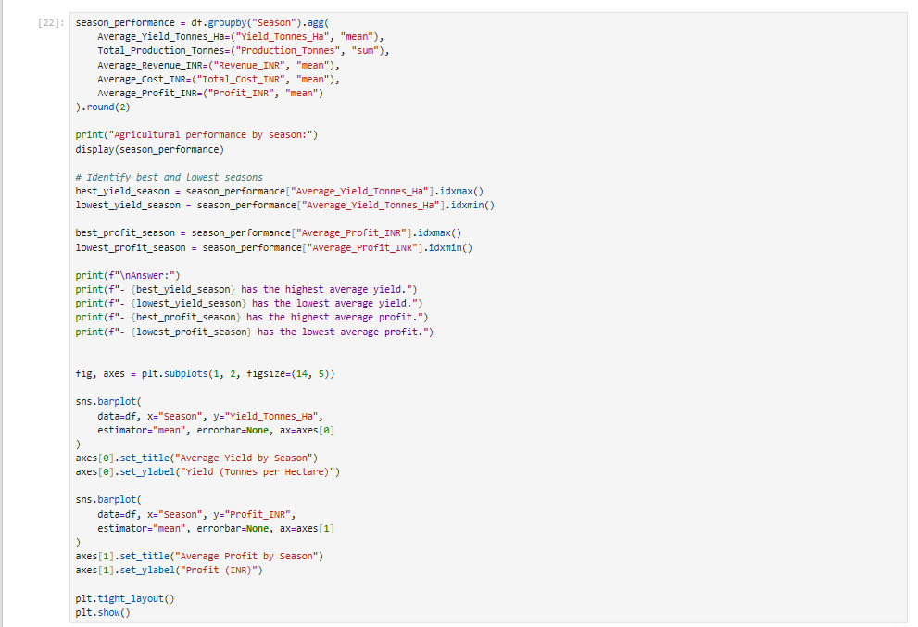
How does agricultural performance vary across seasons?

Slide 14
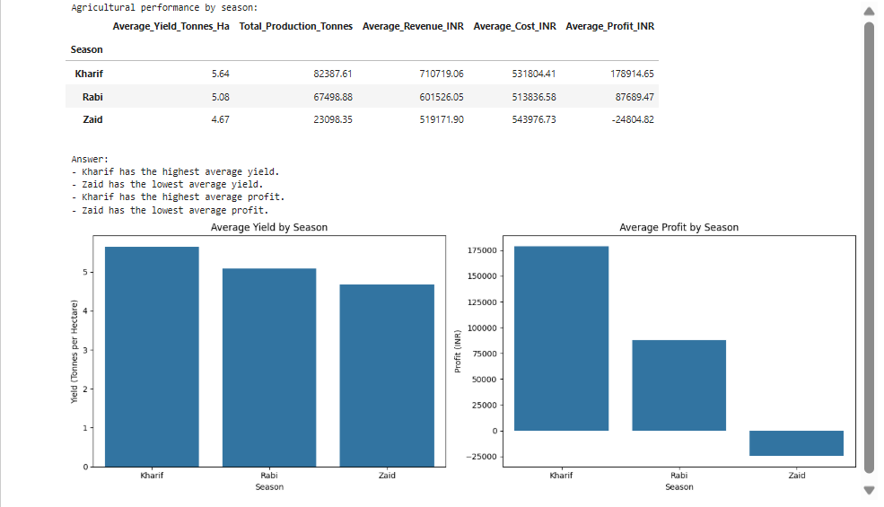

Slide 15
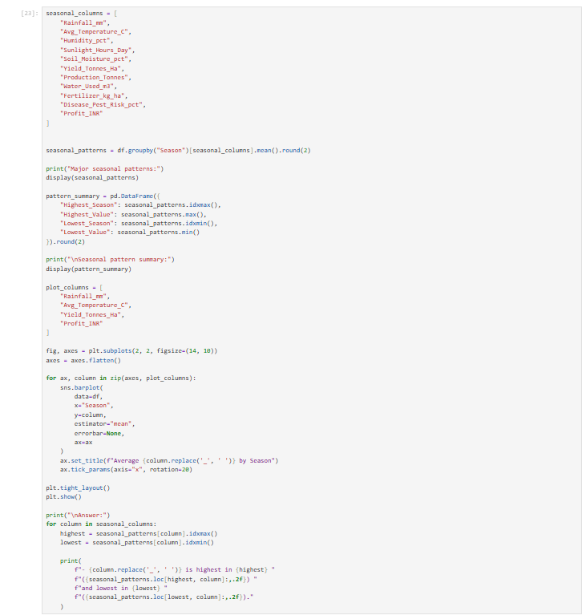
What major seasonal patterns can be observed?

Slide 16
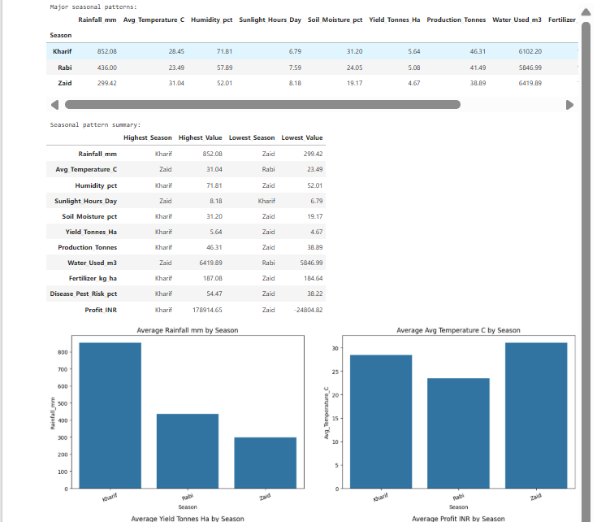

Slide 17
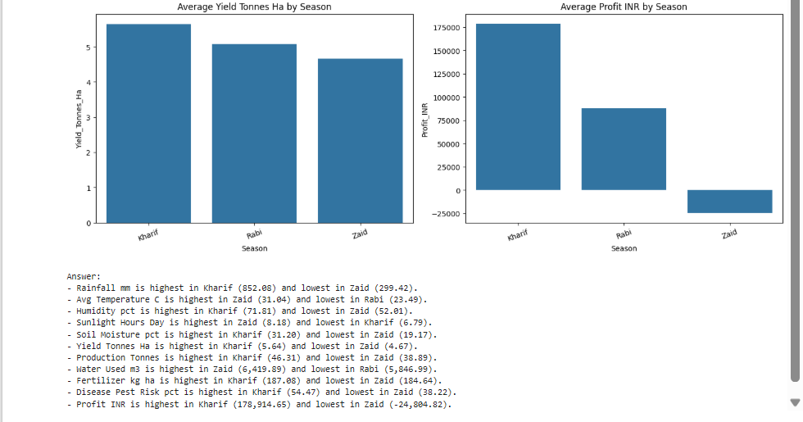

Slide 18
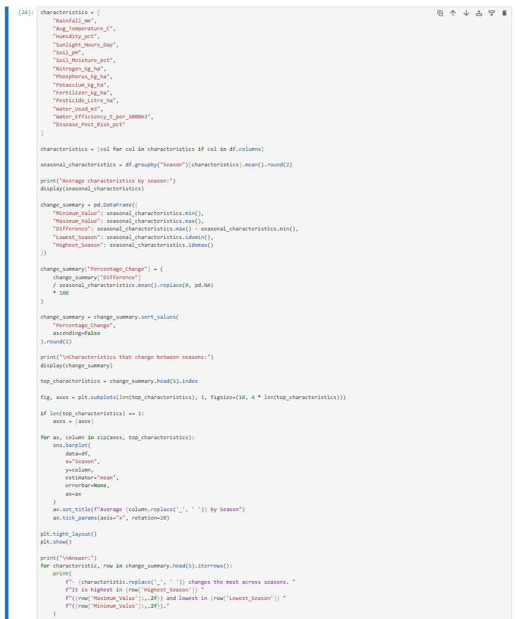
Which characteristics change between seasons?

Slide 19
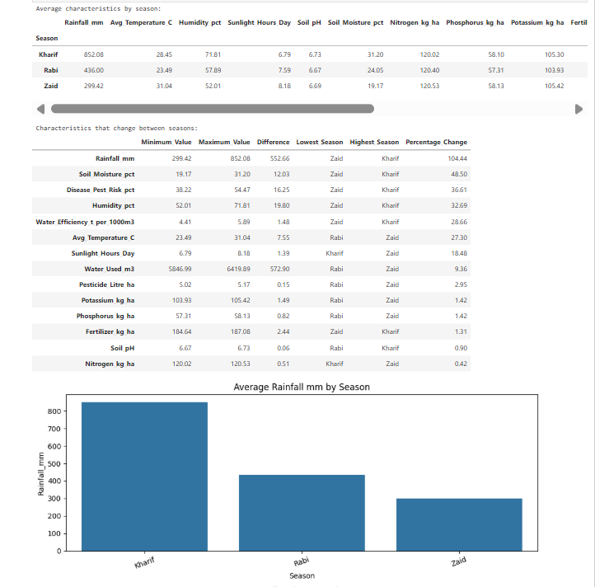

Slide 20
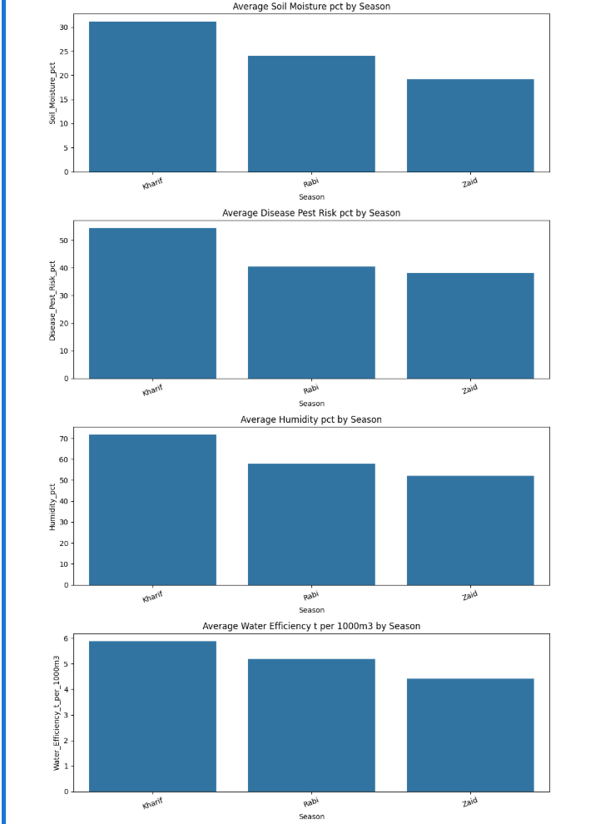

Slide 21


Slide 22
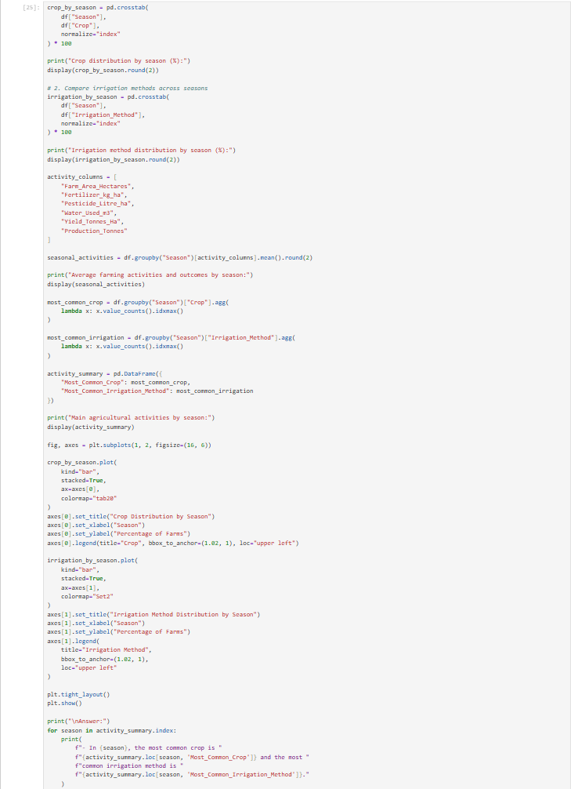
What differences exist between agricultural activities in different seasons?

Slide 23
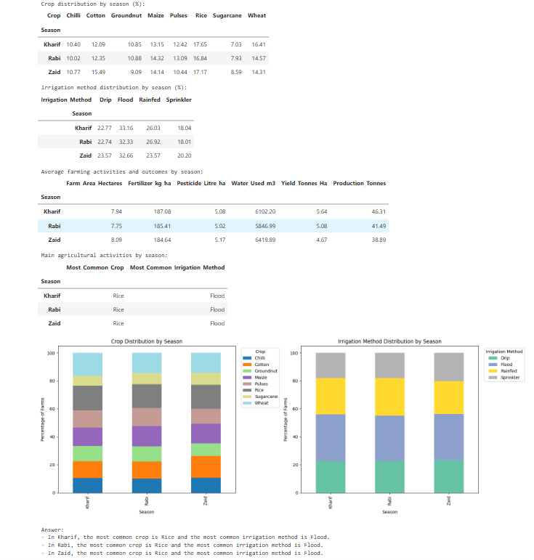

Slide 24
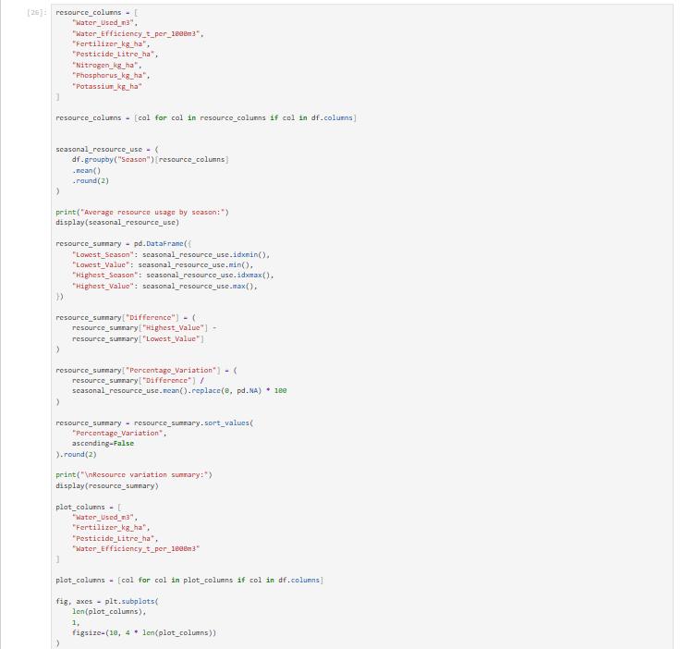
Are there noticeable variations in resource usage across seasons?

Slide 25
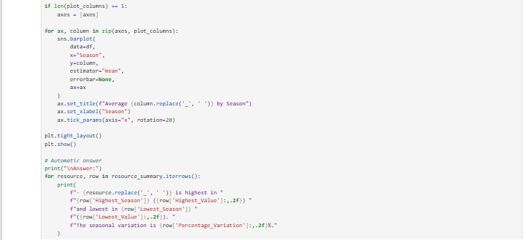

Slide 26
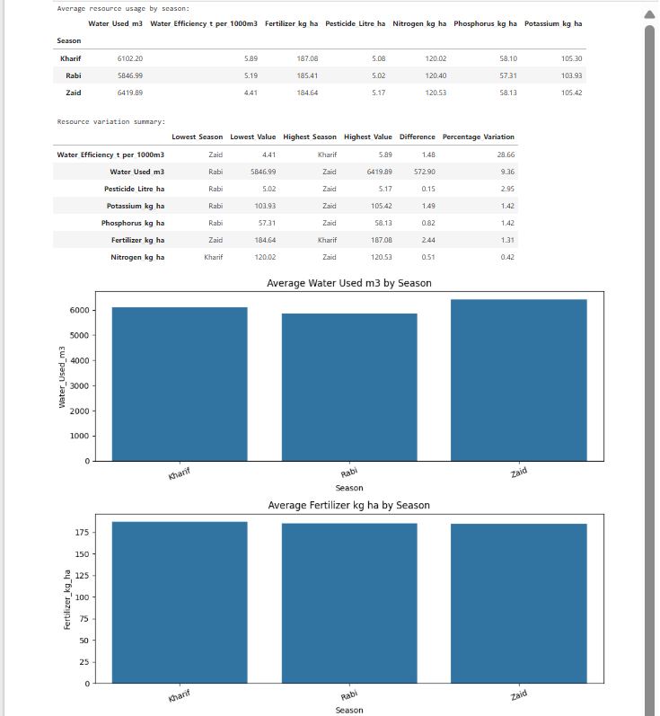

Slide 27
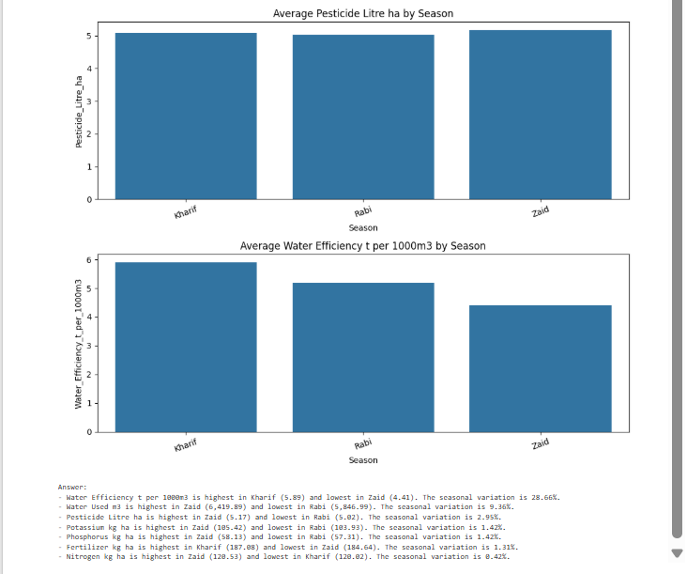

Slide 28
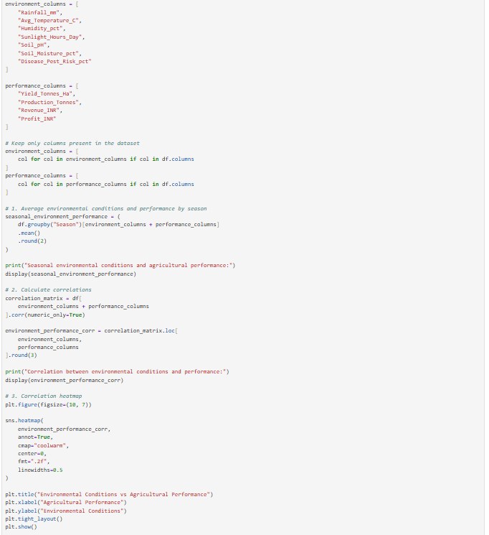
Are there relationships between seasonal environmental conditions and agricultural performance?

Slide 29
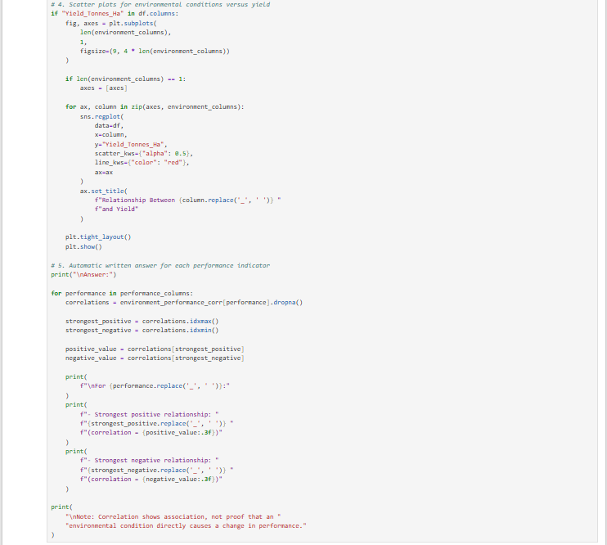

Slide 30
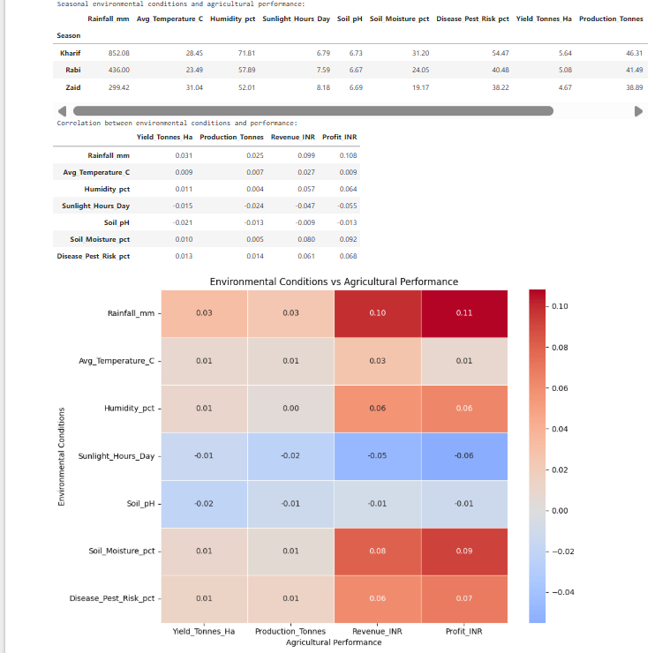

Slide 31
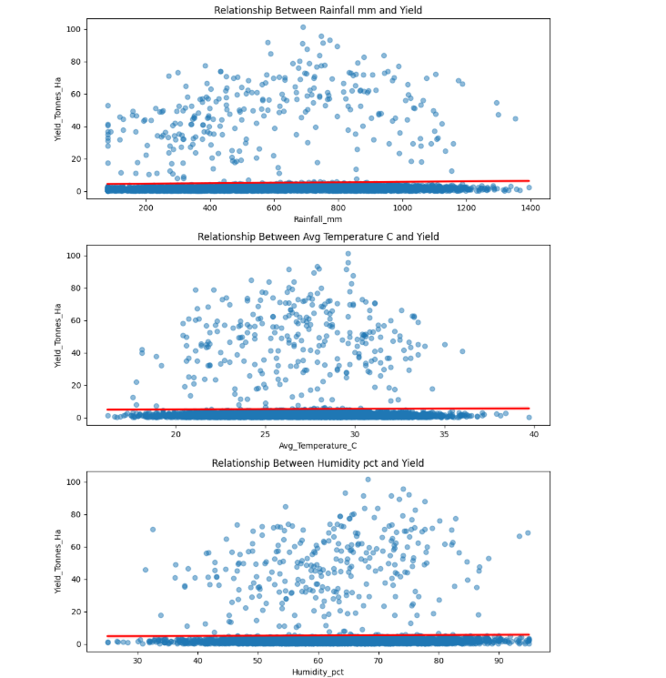

Slide 32
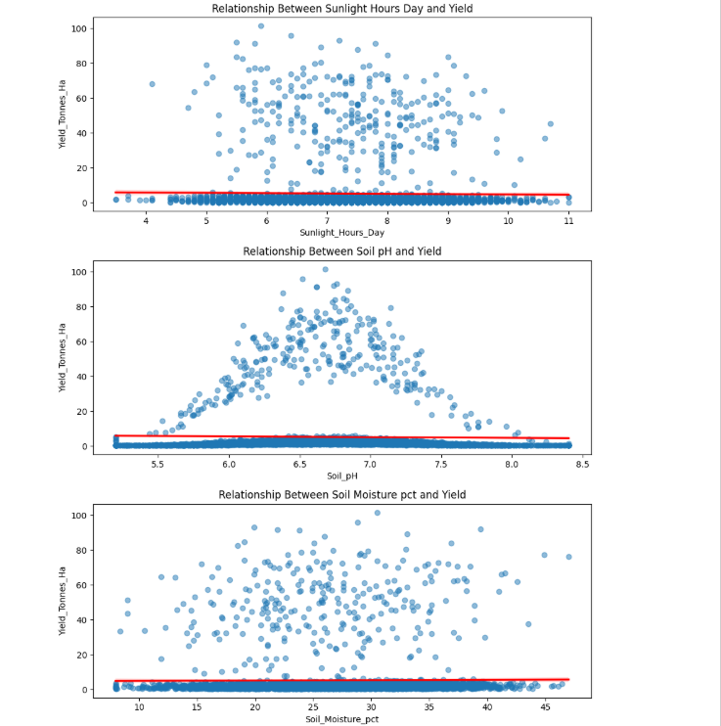

Slide 33
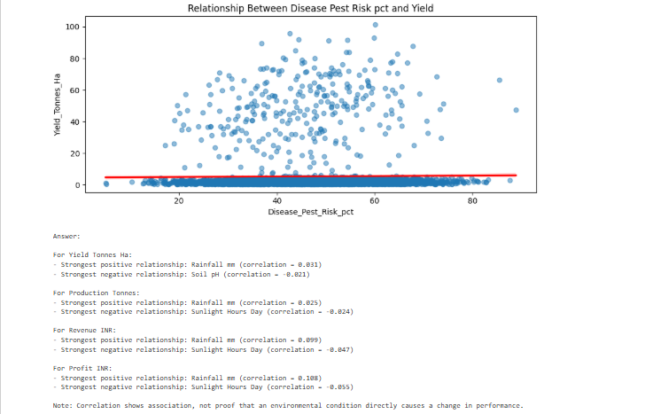

Slide 34
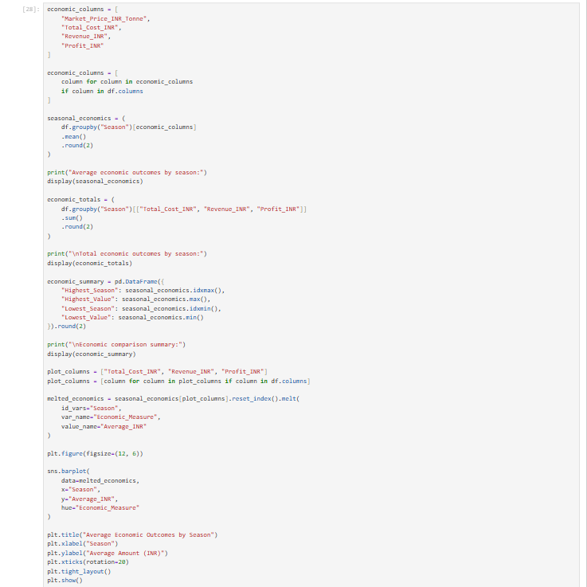
How do economic outcomes vary across seasons?

Slide 35
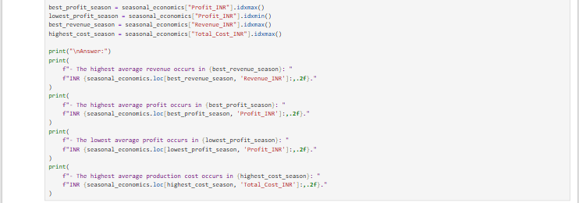

Slide 36
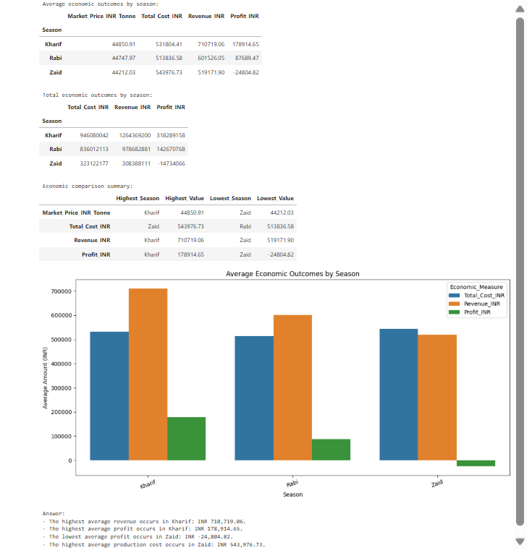

Slide 37
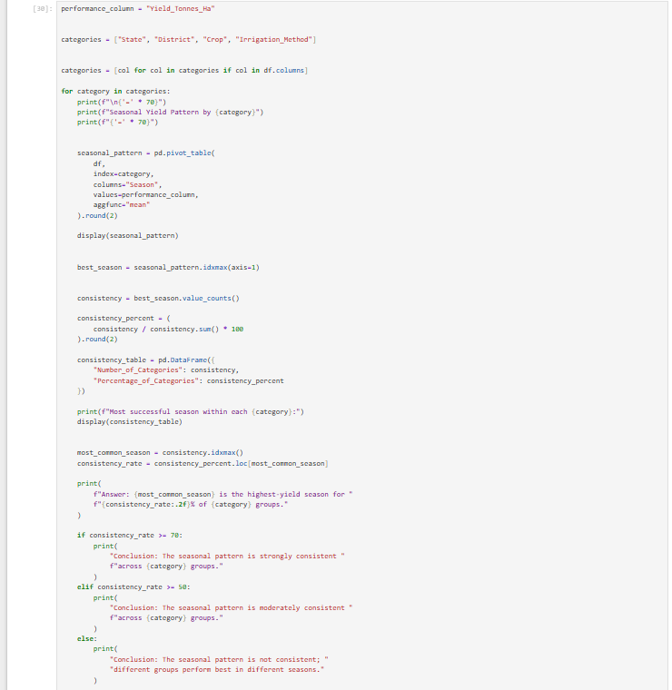
Are some seasonal patterns consistent across different regions or categories?

Slide 38
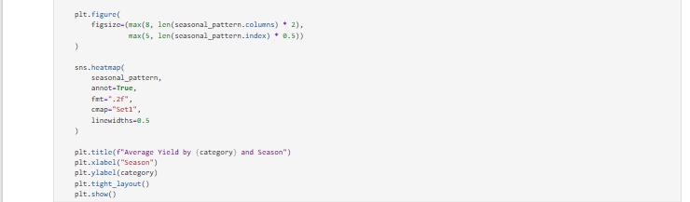

Slide 39
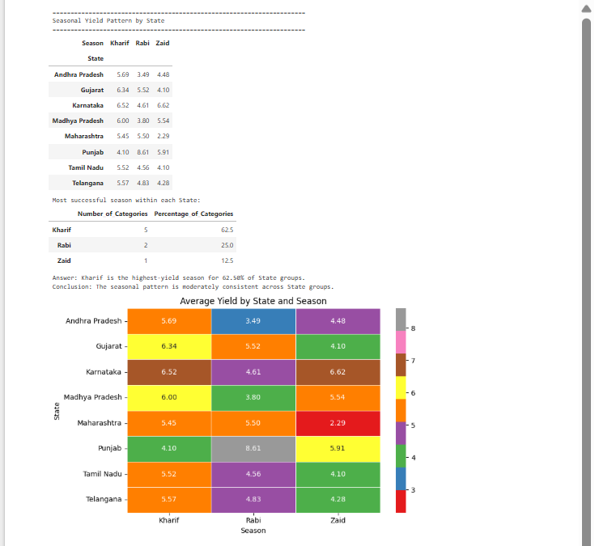

Slide 40
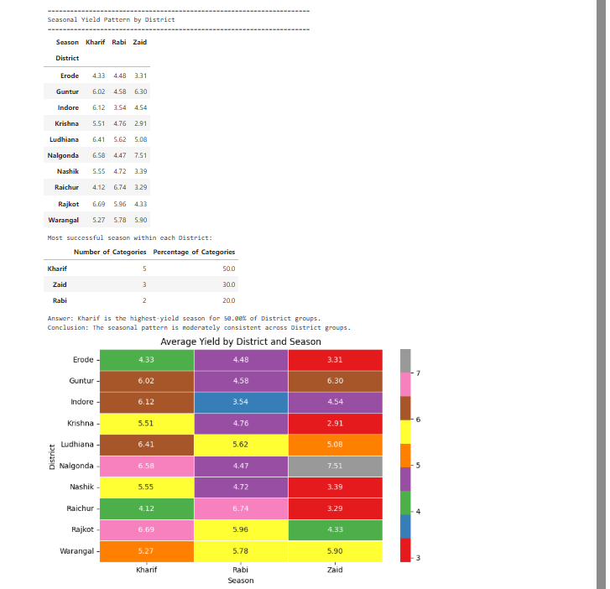

Slide 41
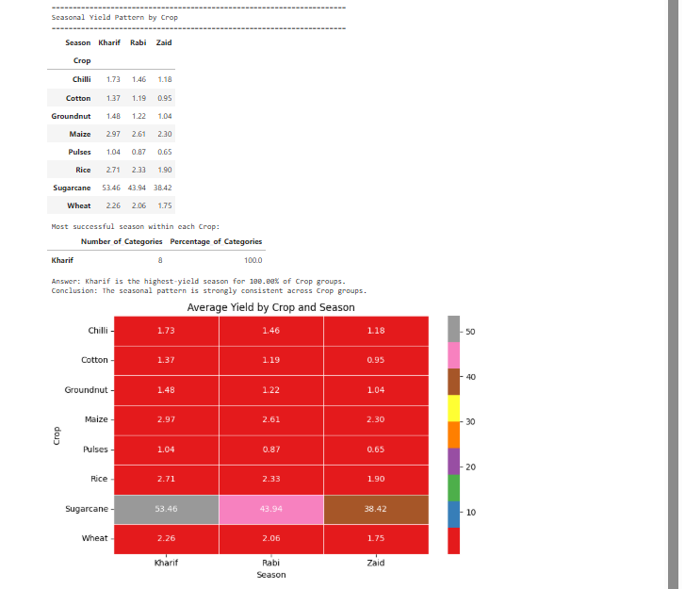

Slide 42
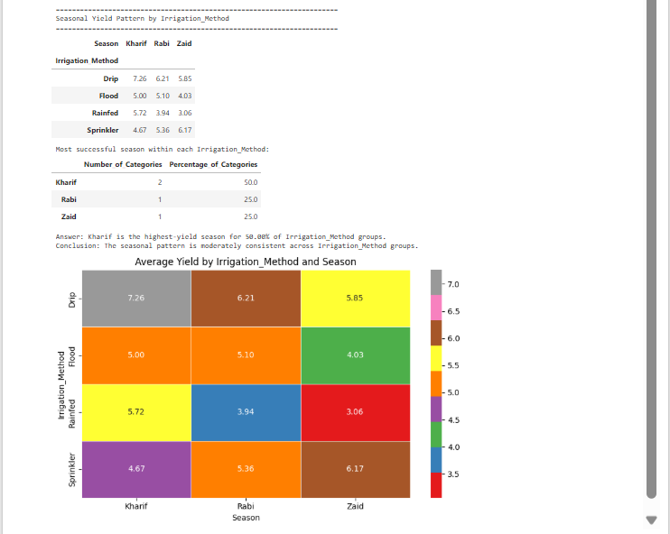

Slide 43
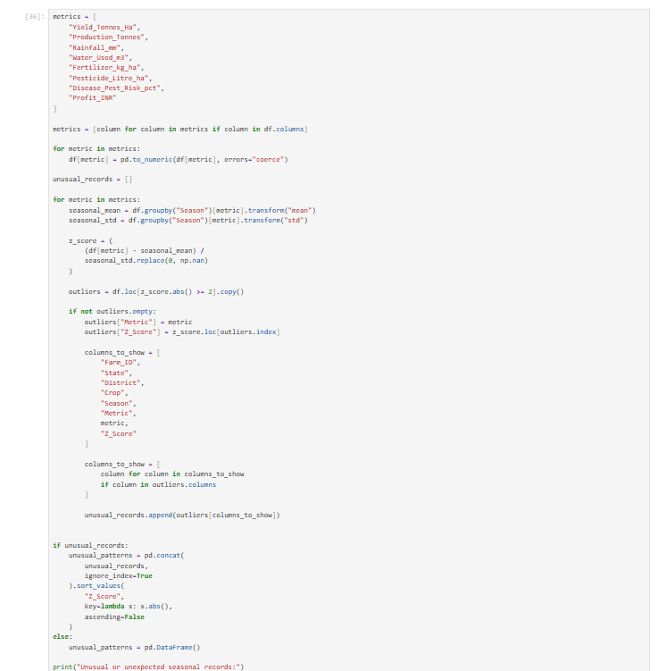
Are there unusual or unexpected seasonal patterns?

Slide 44
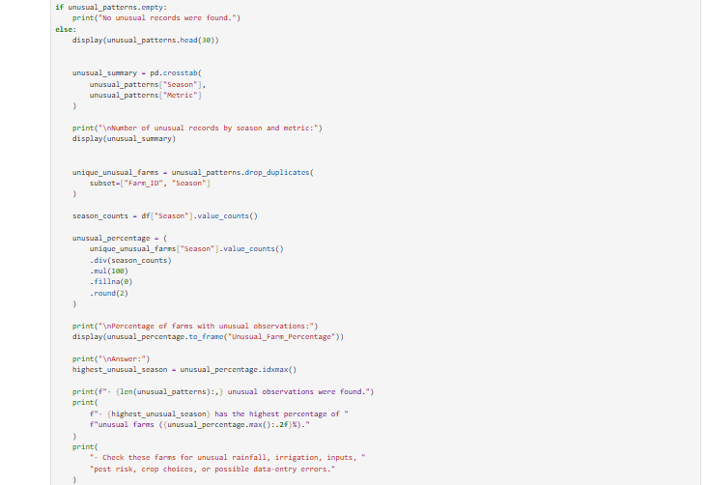

Slide 45
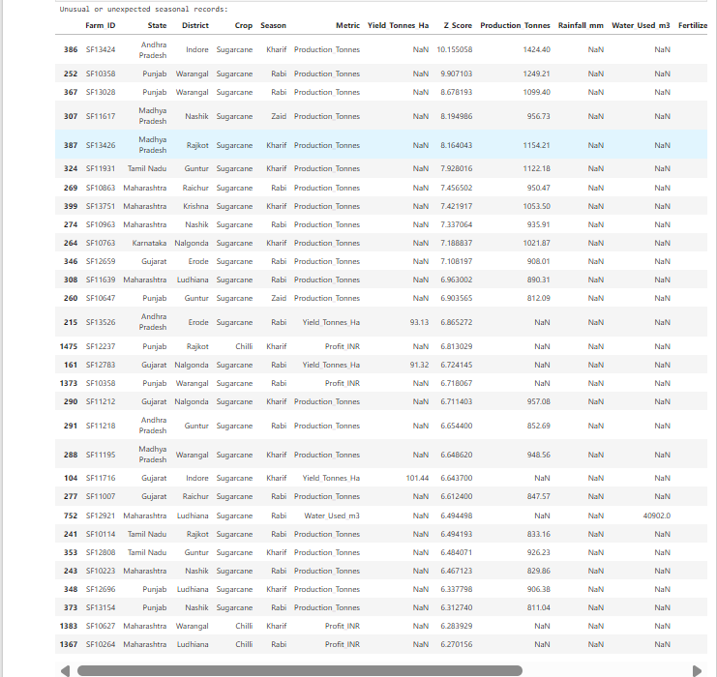

Slide 46
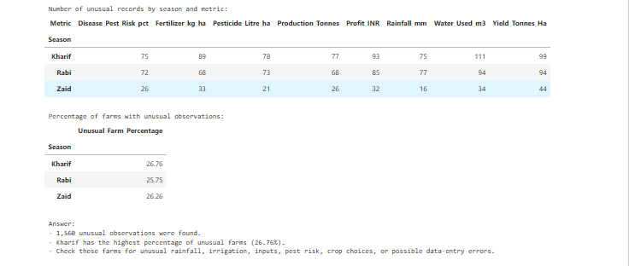

Slide 47
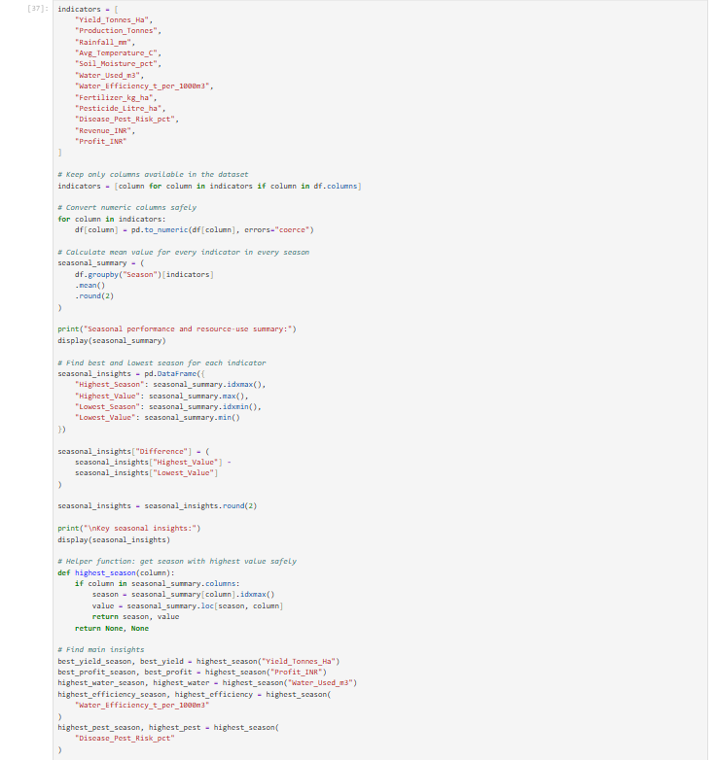
What insights can be derived from the observed seasonal differences?

Slide 48
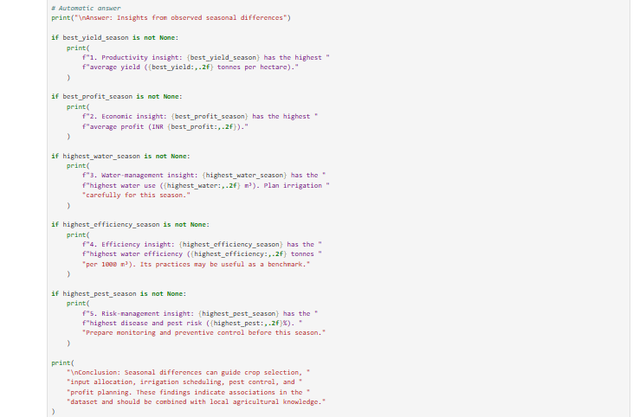

Slide 49
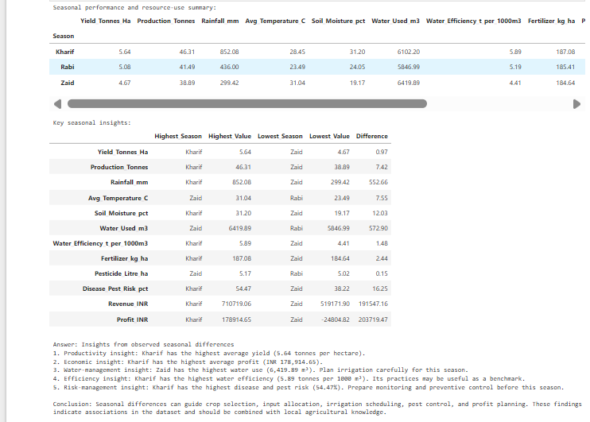

Slide 50
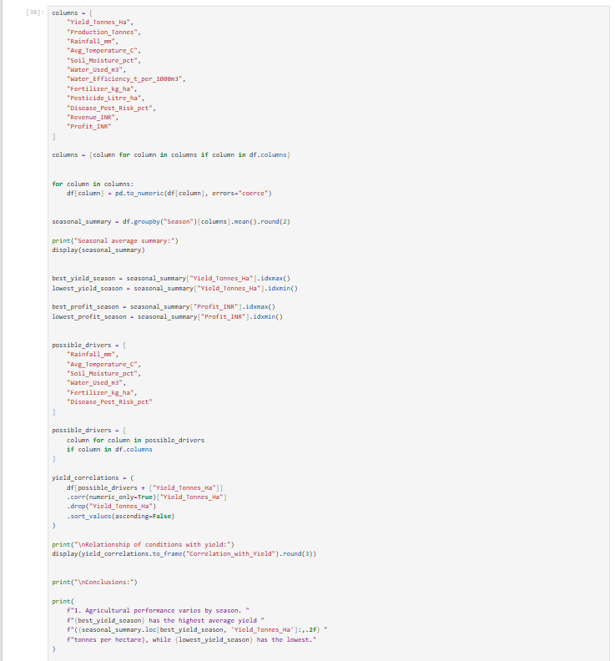
What conclusions can reasonably be drawn from the available data?

Slide 51
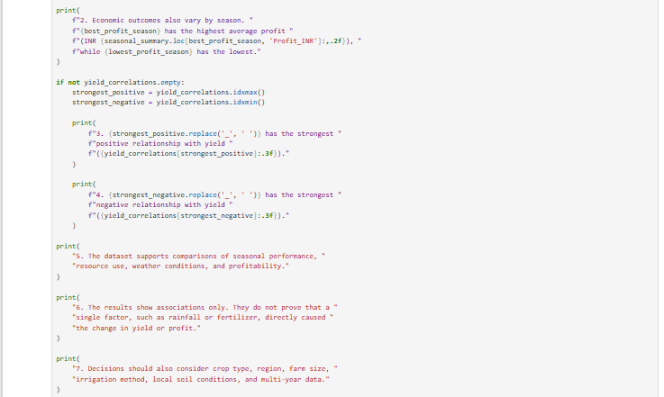

Slide 52
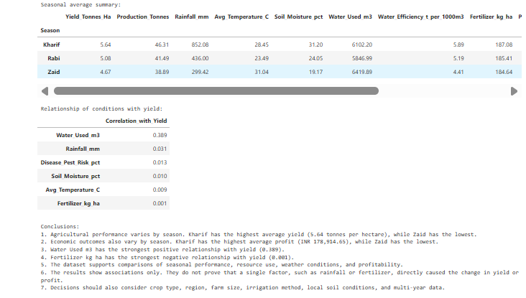

Slide 53
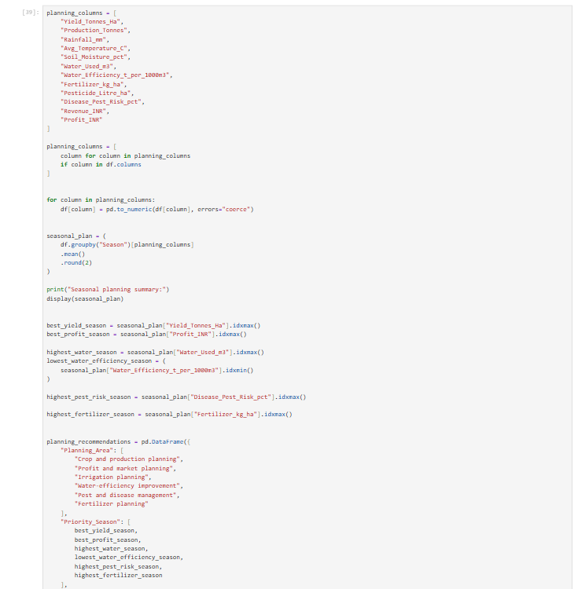
How could the findings support better seasonal agricultural planning?

Slide 54
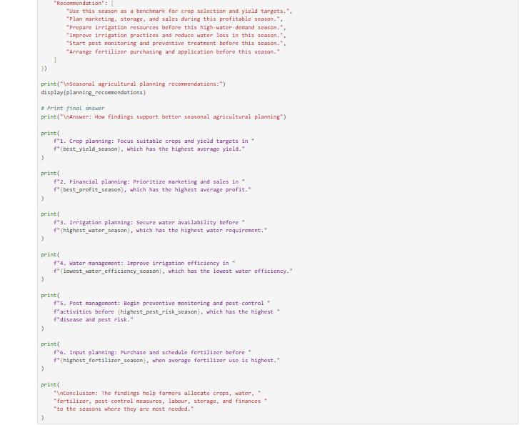

Slide 55
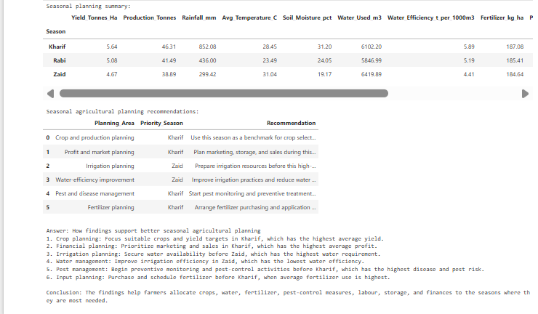

Slide 56
Future Scope
1. Prediction modelling & AI integration : Development of machine learning based models to predict yield, profit and disease/pest risks before harvest allowing timely and proactive decision making.
Deep learning / time-series models for season-wise yield predictions using trend analysis based on past season yields.
2. Real-time Data Integration: Integration of live weather feeds, satellite imageries, and IoT sensors data (soil moisture, temp) instead of storing static historical data per season.
Integration of Drone / remote sensing data for crop health monitoring using NDVI analysis.
3. Dataset Enhancement :Inclusion of more crops, regions and multiple year data to improve the generalization capability of the models, including future changes due to global warming and climatic variations.
Adding more parameters such as labor cost, insurance claims, government subsidies, consumer demand, etc.
4. Smart Irrigation & Resource optimization: Recommendation systems for smart irrigation planning based on water efficiency trends.
Linking with smart irrigation hardware to automate water application on the basis of soil conditions and predicted weather.

Slide 57
5. Mobile & Web Based Farmer advisory solution: Developing a Farmer Advisory platform in the form of dashboard or Mobile Application to provide personalized advice on, fertilizer application, type of irrigation, crop choice etc.
Support for multilinguality and voice-enabled interaction for accessibility in rural communities.
6. Risk & Insurance modelling: Development of models based on disease/pest prediction and crop yield variability for dynamic data driven crop insurance premium design.
Alerts for prediction of disease outbreak based on humidity, temperature and historical disease risk indicators.
7. Market price forecasting: Predicting future market price based on production data along with demand and supply of various commodities, helping farmers decide when to sell crops.
8. Sustainability & Climate Resilience Analysis: Analyzing the impact of traditional practices on soil and water usage for sustainable agriculture.
Recommending best irrigation practices and resilient crops for areas prone to climate variability and erratic rainfall.

Slide 58
Conclusion
This project highlights how the analysis combining climatic, soil, agronomic and financial data can support detailed on-farm assessment. In this framework, the project not only investigates how a particular combination of environment and resources affect both yields and financial performance, but provides in-depth understanding into key variables determining yield, and identify directions for better application of water and fertilizers. As a result, farmers can now use improved information in regard to crop selection, timing and extent of irrigation and to support policy makers in formulating better programs targeted for agricultural sector. Agribusiness and financial investors benefit in assessment of financial risk associated to their investments on farms. This offers robust basis for data driven agriculture aimed to increase productivity and improve economic and environmental efficiency and there can be scope for further project developments such as predictive yield modeling, data incorporation in real-time or development of farming interface.

Slide 59
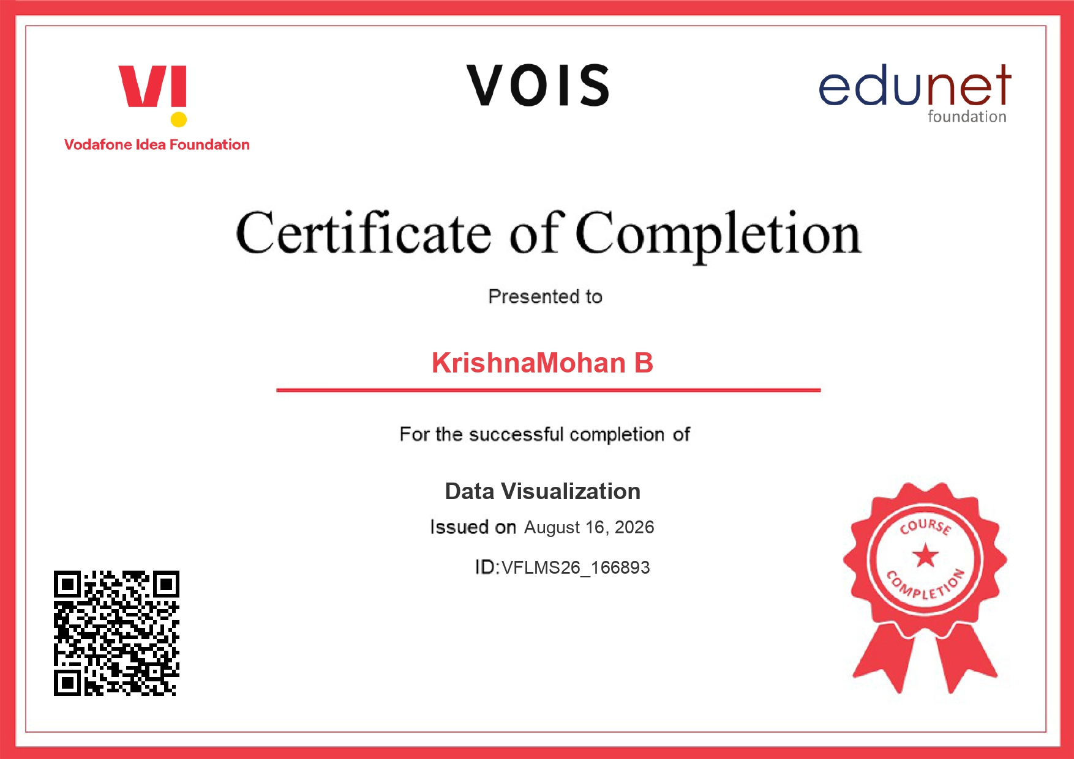
Data Virtualization Certificate

Slide 60
Thank You

